Slide 1

Final Project
IT Talents Season 15

Slide 2

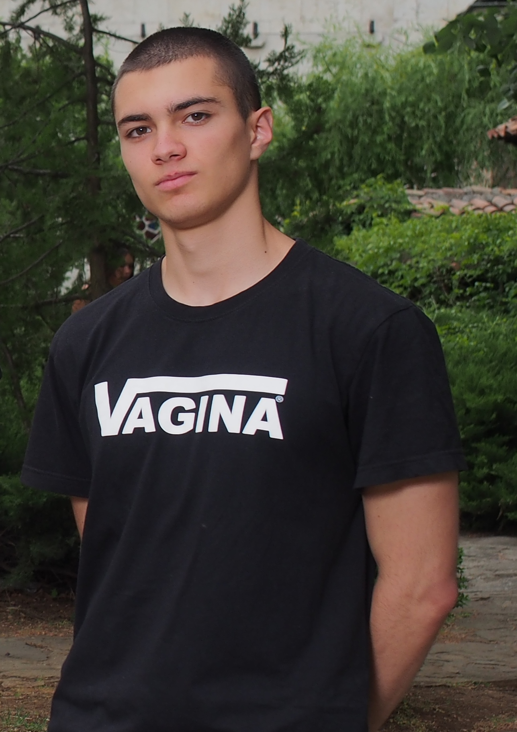
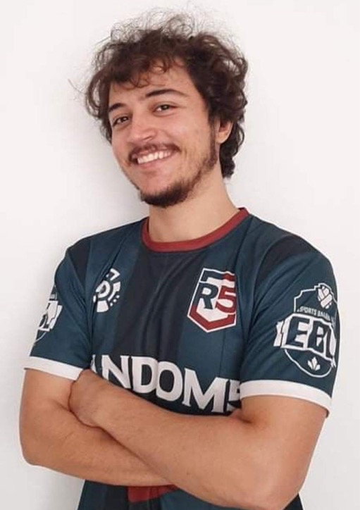

Sasho Tsolov
Iliya Rajgev
23 y/o
Vratsa
Student at FMI
25 y/o
Sofia
Professional gamer

Slide 3



Slide 4



Functionalities
Users
Posts
Comments

Slide 5
Register
Confirm registration via email
Login
Logout
Follow
Block
Forgot password request
Change password
Change/delete profile picture
Change core info of profile
Search other user by name
See followers of user
See who the user follows
View user's core information
Deactivate account
Delete

Slide 6

Add post
Like post
Save post
Tag user in post
View post with all comments and user core info
View all posts of user:
own / tagged in / saved
View feed
Search posts by location/hashtag
Edit post caption
Delete

Slide 7

Add
Like
Reply
Delete

Slide 8
What we used
Software
Spring
Others
Storage
Maven
Tomcat
Spring boot
Spring Web
Spring JPA
Hibernate
JDBC API
MySQL Driver
Lombok
Flyway
Model Mapper
Spring validation
Bcrypt Password Encoder
Java Mail Sender
Cron job
IntelliJ IDEA
MySQL
Workbench
Postman
Git
GitHub
ChatGPT
Swagger
S3
EC2
RDS

Slide 9
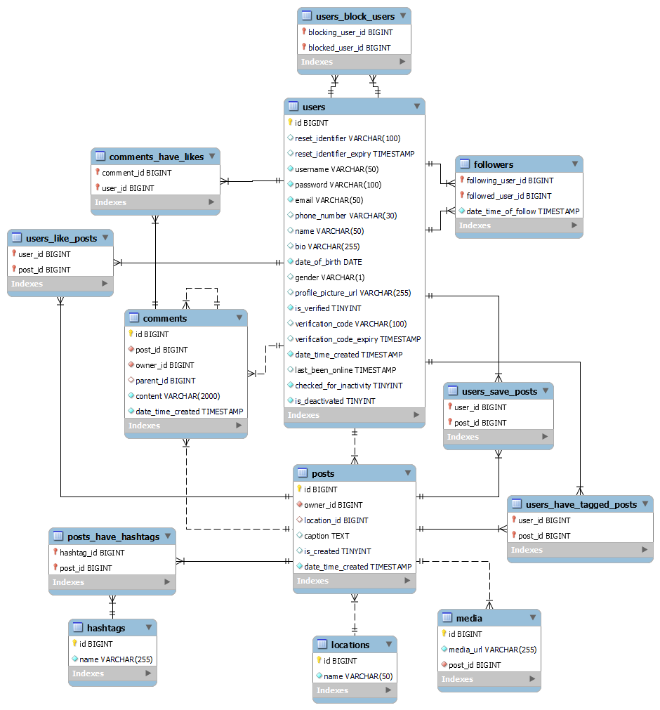

Slide 10
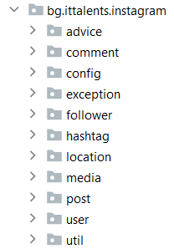
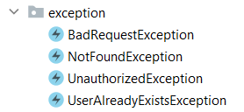
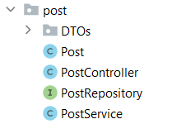
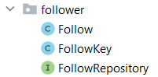
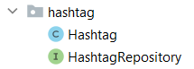
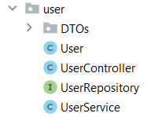
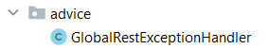
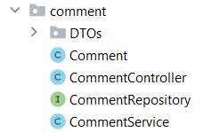
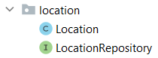
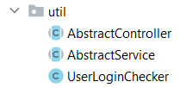
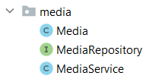
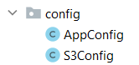
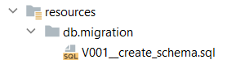

Slide 11
DEMO

Slide 12
THANK YOU!

